Slide 1
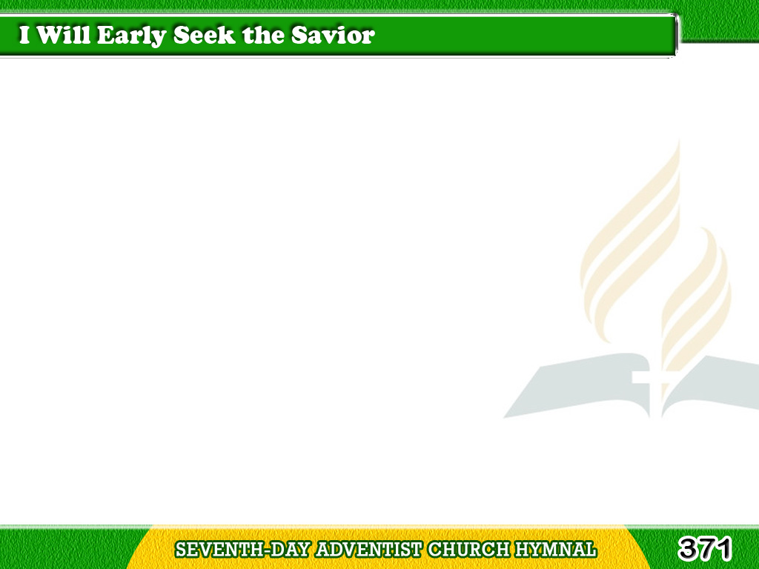
1/3
I will early seek the savior,
I will learn of Him each day;
I will follow in His footsteps,
I will walk the narrow way.
Tagalog
Version

Slide 2
1/3
Chorus
For He loves me,
yes, He loves me,
Jesus loves me, this I know.
Jesus loves me, died to save me,
This is why I love Him so.
Tagalog
Version

Slide 3
2/3
I will hasten where He bids me,
I am not too young to go
In the pathway where He leadeth,
Not too young His will to know.
Tagalog
Version

Slide 4
2/3
Chorus
For He loves me,
yes, He loves me,
Jesus loves me, this I know.
Jesus loves me, died to save me,
This is why I love Him so.
Tagalog
Version

Slide 5
3/3
He is standing at the doorway
Of escape from every sin;
I will knock, for He has promised,
He will hear and let me in.
Tagalog
Version

Slide 6
3/3
Chorus
For He loves me,
yes, He loves me,
Jesus loves me, this I know.
Jesus loves me, died to save me,
This is why I love Him so.
Tagalog
Version

